Slide 1
RMS Urban Garden & Garden Club
Sponsors: Christy Dion, Ilea Crum, & Christy Falls

Slide 2
Urban Garden Mission
The P. B. Ritch Middle School Garden will be created with the belief that every child should have the opportunity to learn basic concepts from nature itself. Our aim is to promote community, socially responsible, culturally sensitive and environmentally aware behavior through the growth of our urban garden.

Slide 3
Ritch Urban Garden Vision Statement
Our urban garden will be an oasis, designed to attract and protect countless organisms like bees, fish, and worms. Our design includes lush habitats of raised beds made from recyclable materials. Each garden bed will encompass multiple disciplines including language arts, math, social studies, science, art, and more. In addition, we plan to have a small hydroponic system with live fish as well as a sensory garden. This sensory garden will be filled with plants show look, feel, and taste invite exploration for classes or individual students who need nature therapy. Each year, our plan is to have every Ritch classroom visit the garden for at least one learning experience.

Slide 4
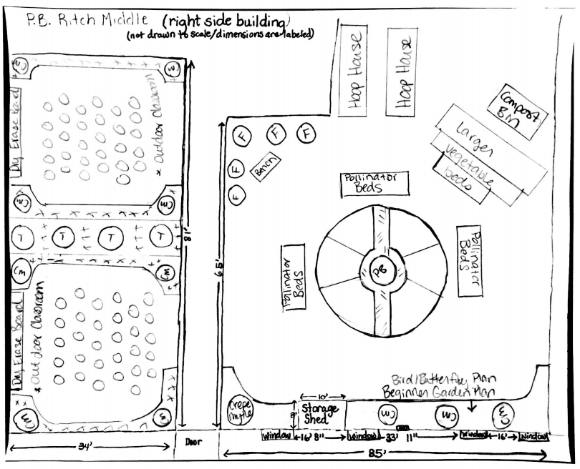
Plan A: Pollinator Gardens & Planetary Pizza Garden

Slide 5
Garden Club
Vision for our students

Slide 6
CREATE/MAINTAIN

Slide 7
HEALTHY LIFESTYLES
PICKING THE FRUITS OR YOUR LABOR
FARMER’S MARKET

Slide 8
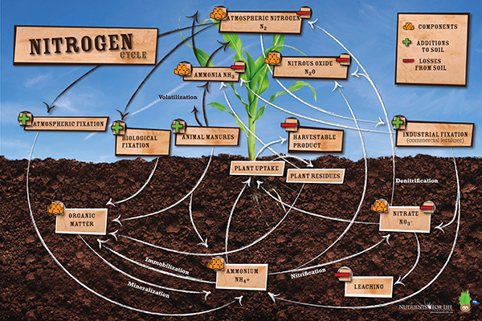
ACADEMIC LEARNING

Slide 9
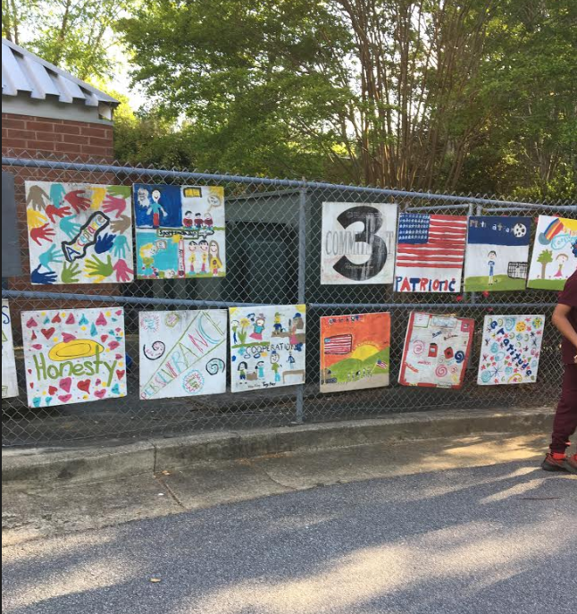
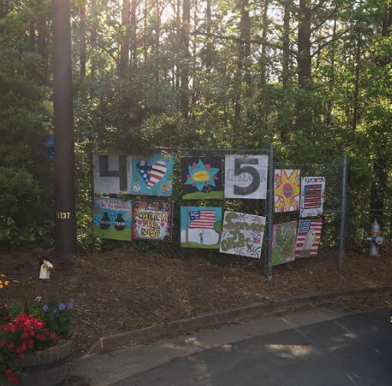
GARDEN EXAMPLES – FORD ELEMENTARY “ART IN THE GARDEN”

Slide 10
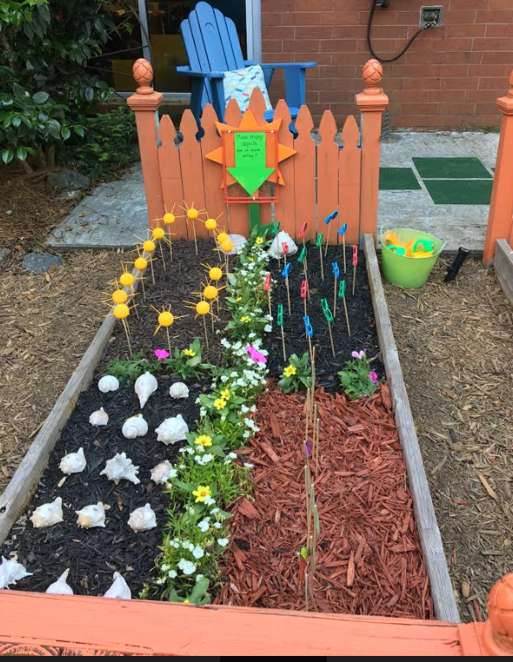
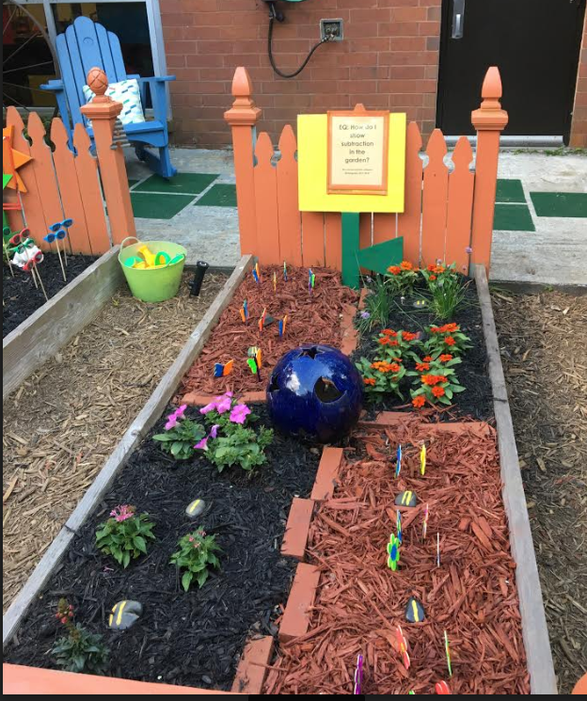
GARDEN EXAMPLES – FORD ELEMENTARY “MATH IN THE GARDEN”

Slide 11
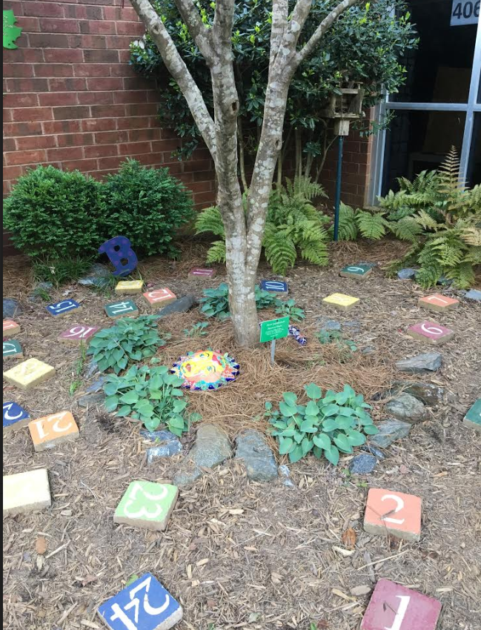
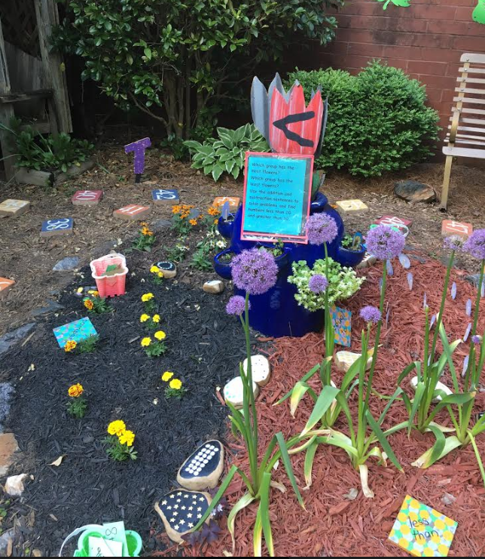
GARDEN EXAMPLES – FORD ELEMENTARY “MATH IN THE GARDEN”

Slide 12
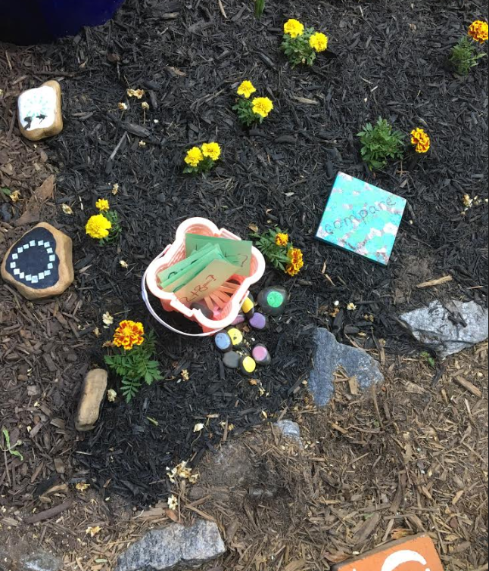
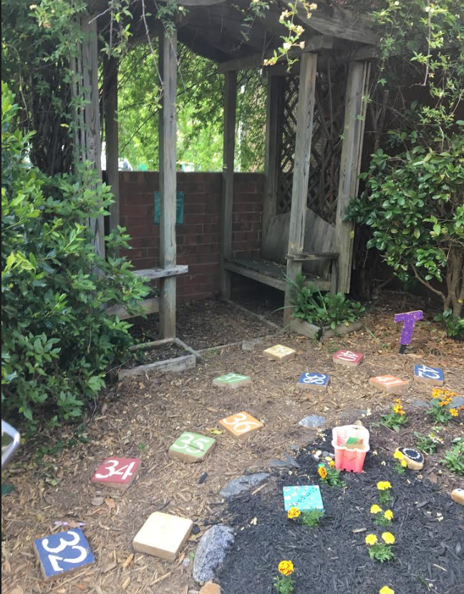
GARDEN EXAMPLES – FORD ELEMENTARY “MATH IN THE GARDEN”

Slide 13
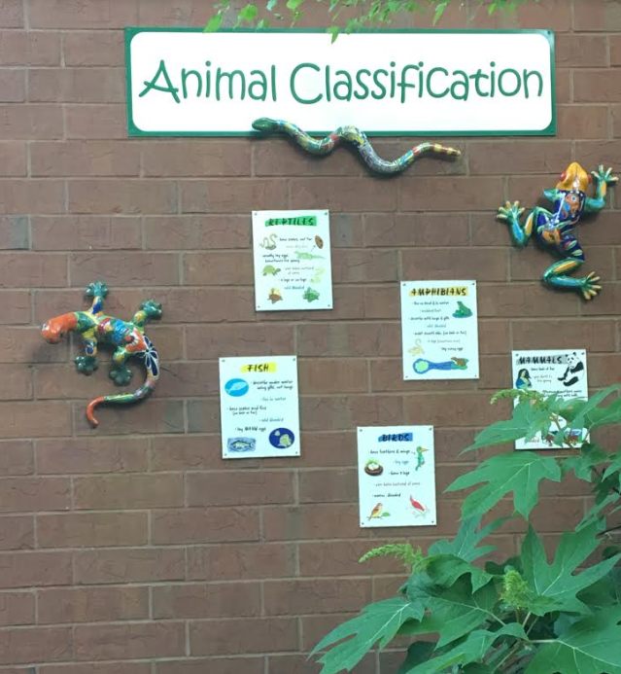
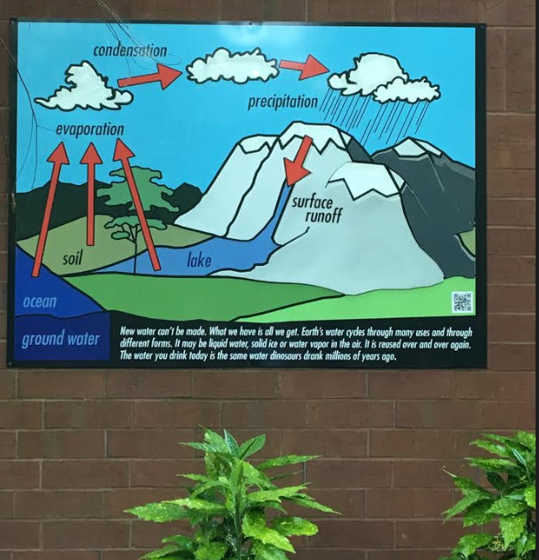
GARDEN EXAMPLES – FORD ELEMENTARY “SCIENCE IN THE GARDEN”

Slide 14
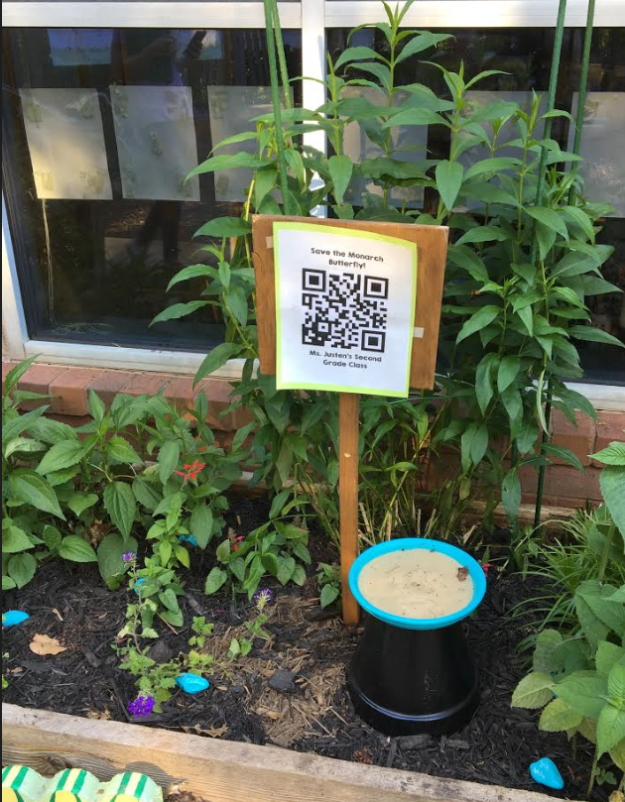
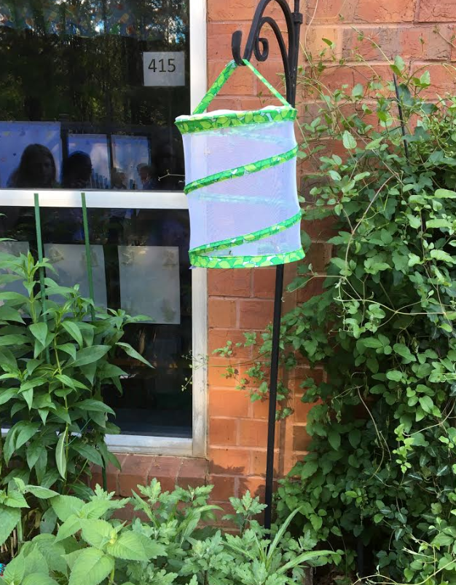
GARDEN EXAMPLES – FORD ELEMENTARY “SCIENCE IN THE GARDEN”

Slide 15
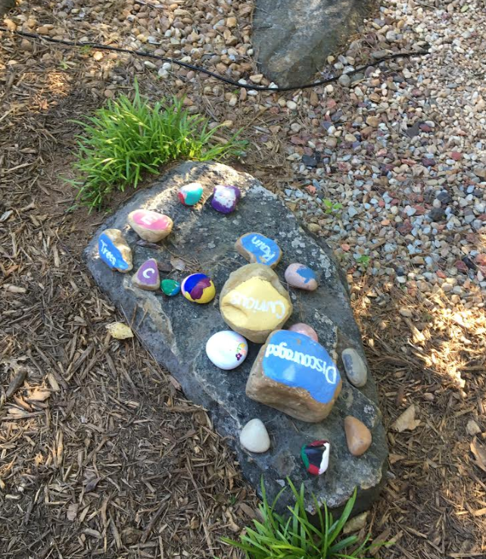
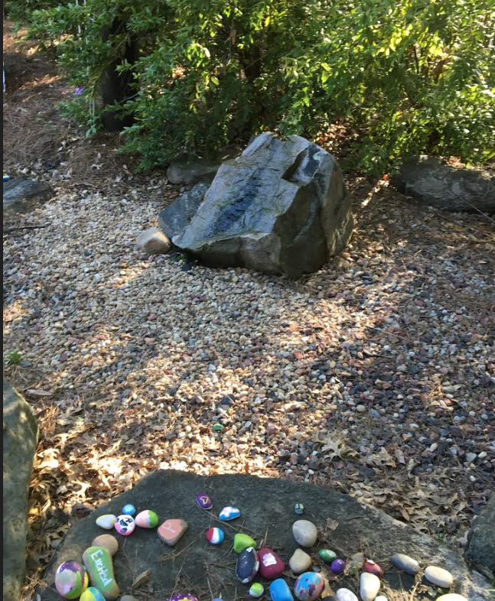
GARDEN EXAMPLES – FORD ELEMENTARY “FEELINGS GARDEN”

Slide 16
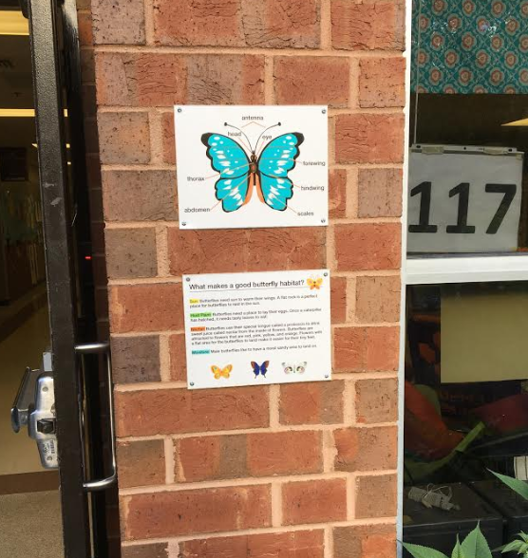
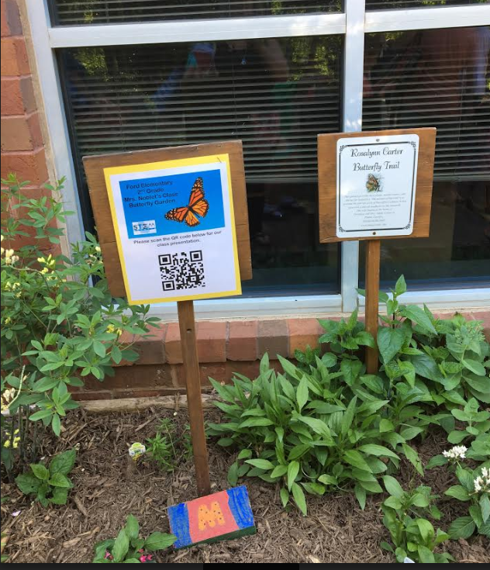
GARDEN EXAMPLES – FORD ELEMENTARY “LESSONS IN THE GARDEN”

Slide 17
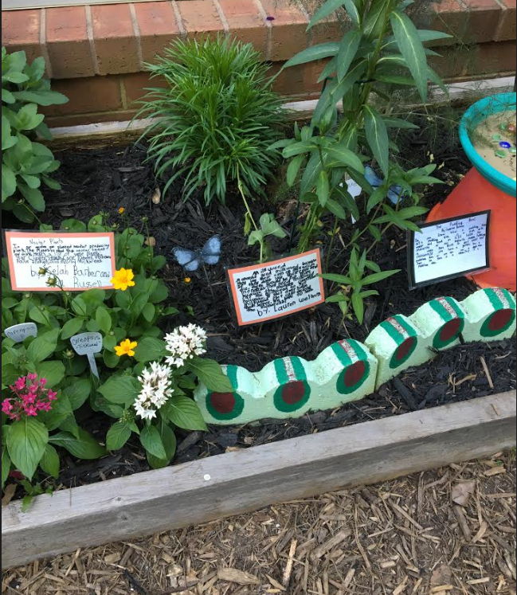
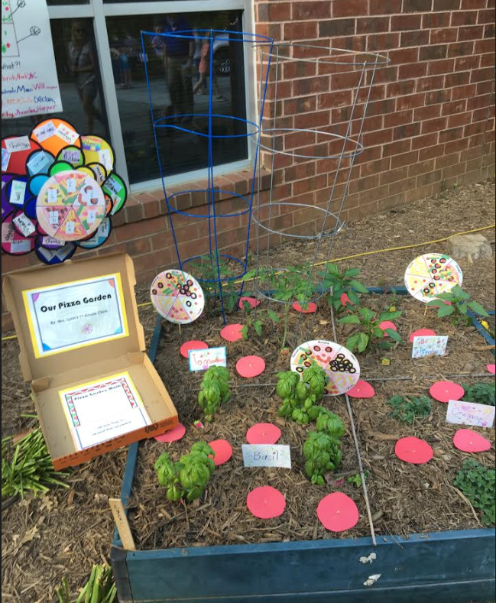
GARDEN EXAMPLES – FORD ELEMENTARY “LESSONS IN THE GARDEN”

Slide 18
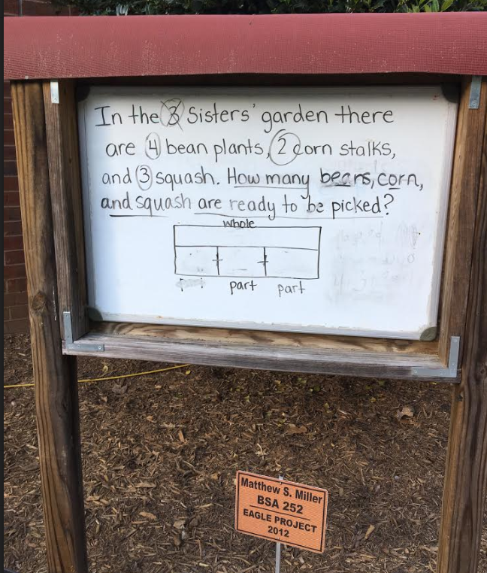
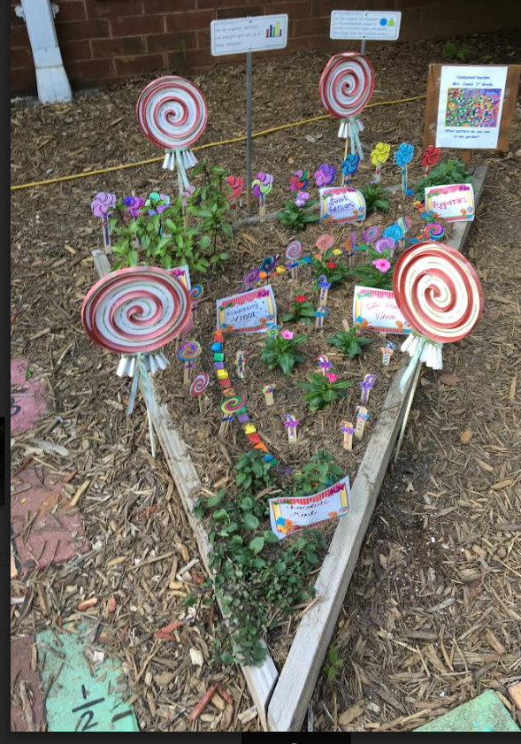
GARDEN EXAMPLES – FORD ELEMENTARY “LESSONS IN THE GARDEN”

Slide 19
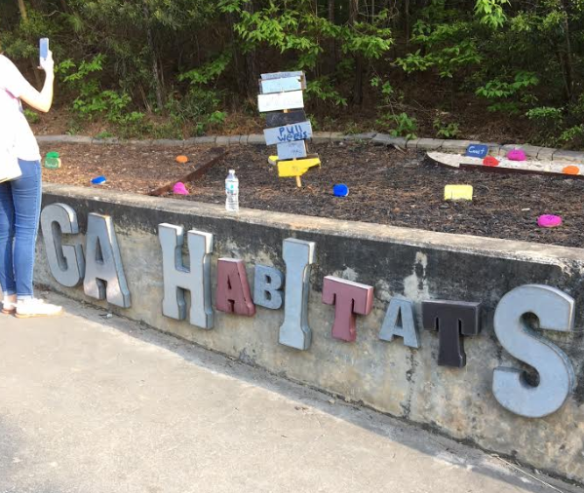
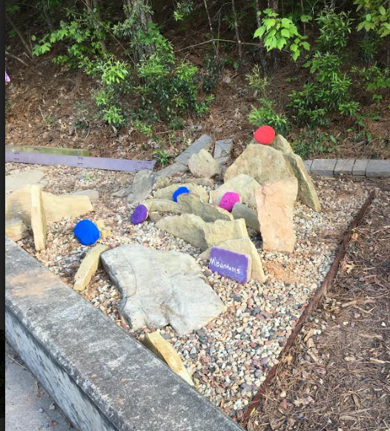
GARDEN EXAMPLES – FORD ELEMENTARY “LESSONS IN THE GARDEN”

Slide 20
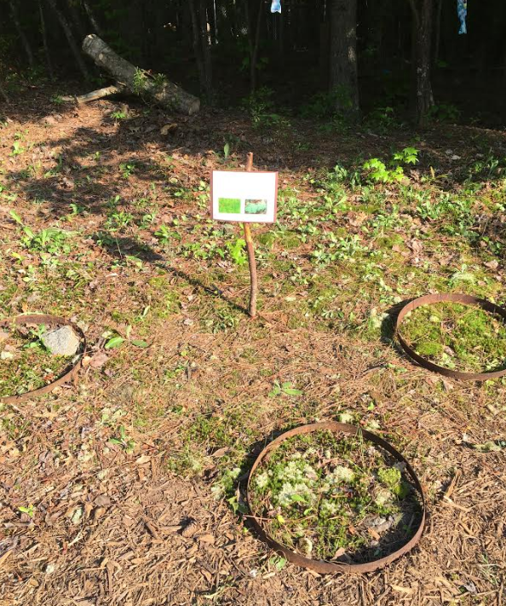
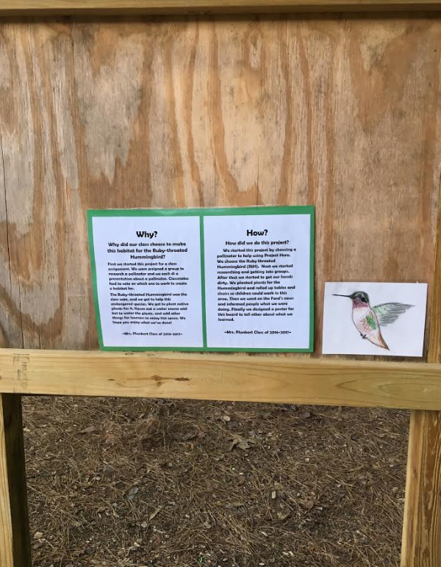
GARDEN EXAMPLES – FORD ELEMENTARY “LESSONS IN THE GARDEN”

Slide 21
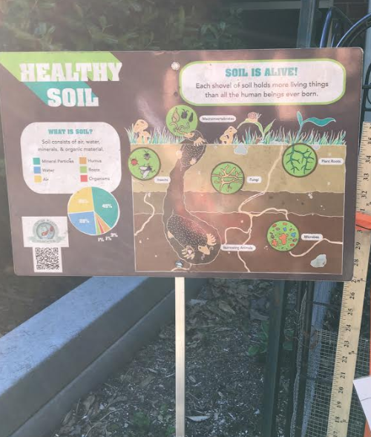
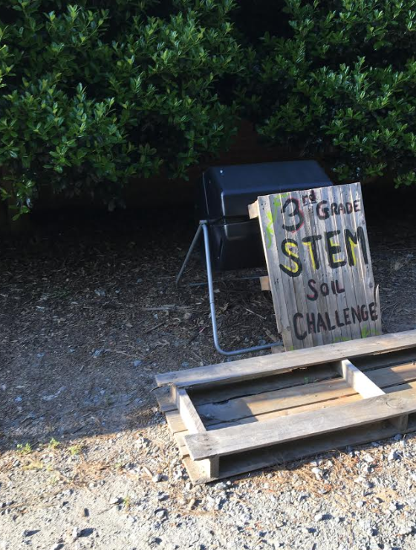
GARDEN EXAMPLES – FORD ELEMENTARY “LESSONS IN THE GARDEN”

Slide 22
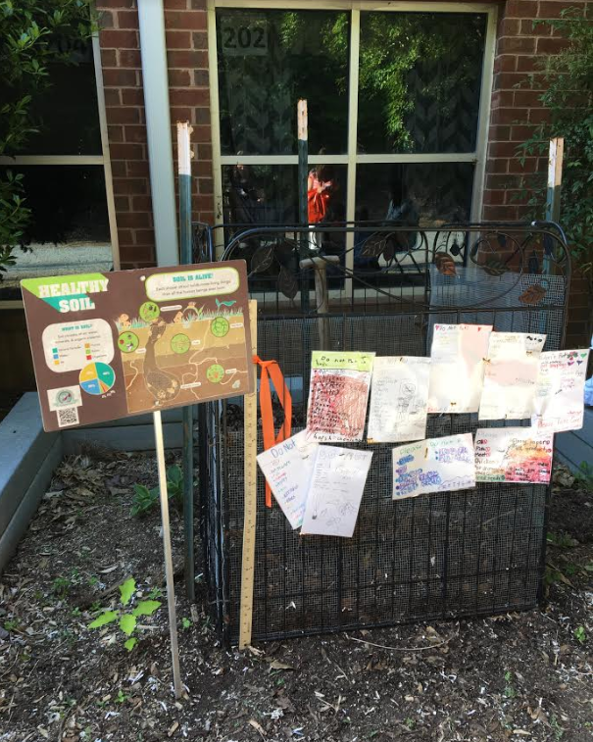
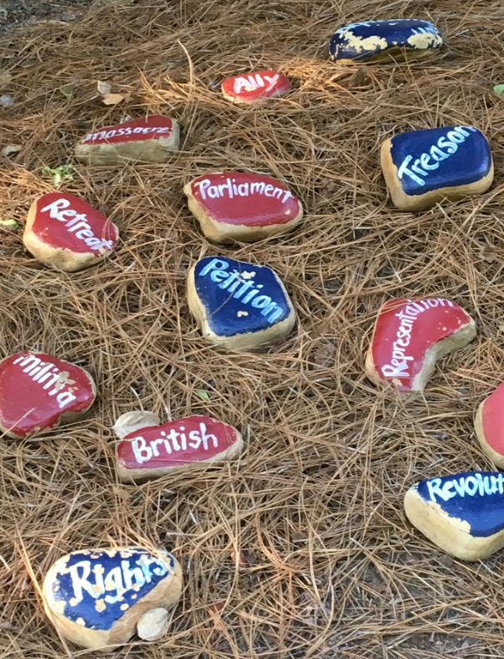
GARDEN EXAMPLES – FORD ELEMENTARY “LESSONS IN THE GARDEN”

Slide 23
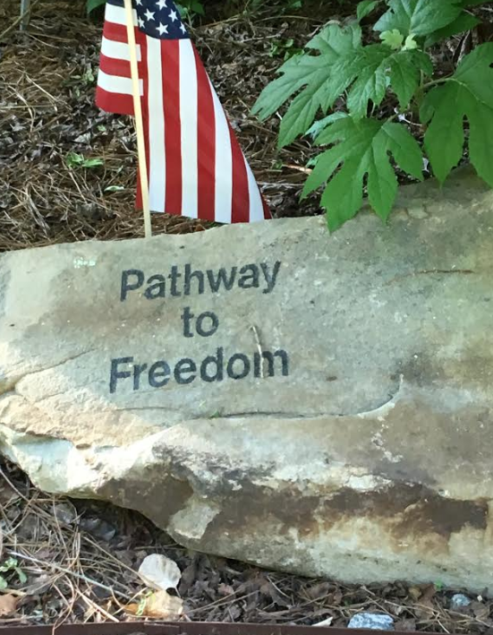
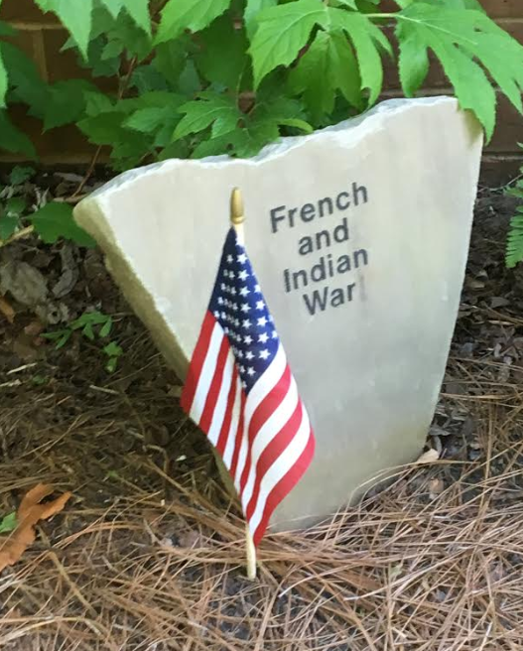
GARDEN EXAMPLES – FORD ELEMENTARY “LESSONS IN THE GARDEN”

Slide 24
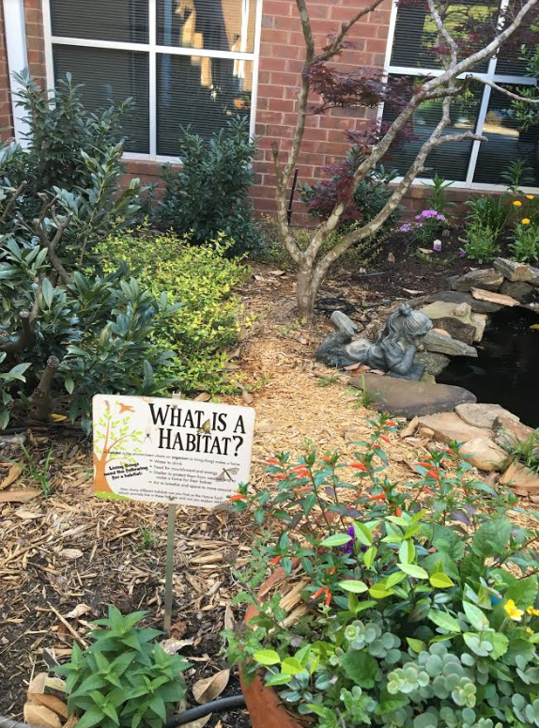
GARDEN EXAMPLES – FORD ELEMENTARY “LESSONS IN THE GARDEN”

Slide 25
CITIZEN SCIENCE – GARDEN CONNECTIONS ON A GLOBAL LEVEL

Slide 26
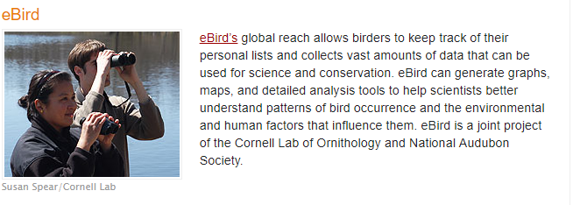
CITIZEN SCIENCE – GARDEN CONNECTIONS ON A GLOBAL LEVEL

Slide 27
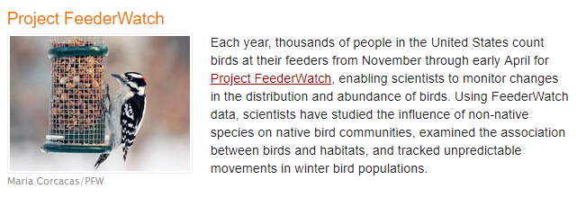
CITIZEN SCIENCE – GARDEN CONNECTIONS ON A GLOBAL LEVEL

Slide 28
CITIZEN SCIENCE – GARDEN CONNECTIONS ON A GLOBAL LEVEL

Slide 29
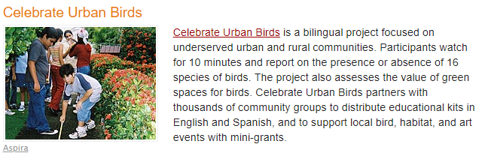
CITIZEN SCIENCE – GARDEN CONNECTIONS ON A GLOBAL LEVEL

